Slide 1
Yoncalla School District
2025-27 Integrated Application
Presentation to Governing Board
Notes:
Suggestion: Add district/applicant logo

Slide 2
Purpose for Presentation
To share what was prioritized in the plan given the range of inputs
To explain how the plan was developed
To hear additional feedback on the plan now that it has been developed
To seek approval from the Yoncalla School Board

Slide 3
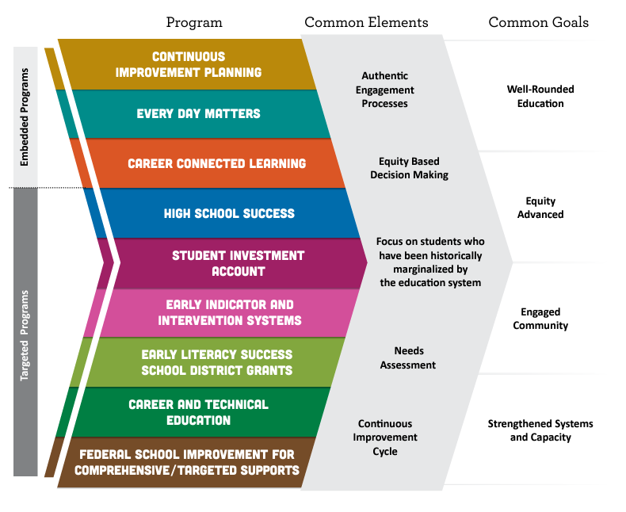
Aligned Programs & Common Goals
Notes:
Suggested Speaker Notes: Integration is possible for these initiatives because of what they have in common. This guidance brings them together so applicants, regions, schools, and programs can leverage multiple strategies and funding sources to implement more cohesive plans that positively impact students. Through the integrated application process, the outcomes and strategies for each initiative will continue to come together into a single strategic plan that supports the common goals. The aim is to build these goals into the entire educational system to embed the work at all levels and ensure sustainability.
Common Engagement of focal student groups presents a unique opportunity and vital resource for collecting high impact community data to inform the practices that impact those same populations. Focal student groups and their families must be engaged in planning under this guidance and there must be demonstrated evidence and artifacts for how engagement strategies/activities impacted your chosen outcomes, priorities, strategies, and activities. Focal student groups are defined within the Student Success Act as “students of color; students with disabilities; emerging bilingual students; and students navigating poverty, houselessness, and foster care; and other students who have historically experienced disparities in our schools”. This list has been expanded in rule to include migratory students, students recently arrived, justice involved youth, and students who identify as LGBTQ2SIA+.
Focal Student Groups:
Students of color;
Students with disabilities;
Emerging bilingual students;
Students navigating poverty, homelessness, and foster care;
Migrant students;
Students with experience of incarceration or detention;
LGBTQ2IA+ students;
Students recently arrived;
Other students who have historically experienced academic disparities.

Slide 4
Summary of Program Purpose
Centering supports from kindergarten readiness through college & career and especially for focal group students.
Continuous Improvement Planning (CIP) - A process involving educator collaboration, data analysis, professional learning and reflection - toward improved outcomes for students and especially students experiencing disparity.
Every Day Matters - (EDM) - Embedded across the five other programs, focusing attention on student engagement, school culture, climate/safety & culturally sustaining pedagogy.
Career Connected Learning (CCL) - Framework of career awareness, exploration, preparation, and training that is both learner-relevant and directly linked to professional and industry-based expectations.
Notes:
Link to Integrated Guidance

Slide 5
Summary of Program Purpose, continued
Centering supports from kindergarten readiness through college & career and especially for students who have experienced disparities.
High School Success (HSS) - Systems to improve graduation rates and college/career readiness.
Student Investment Account (SIA) - To meet students’ mental health, behavioral needs and increase academic achievement/reduce disparities for student focal groups.
Early Indicator and Intervention System (EIIS) - The development of a data collection and analysis system, in which educators collaborate, to identify supports for students.

Slide 6
Summary of Program Purpose, continued
Centering supports from kindergarten readiness through college & career and especially for students who have experienced disparities.
Early Literacy Success School District Grants (ELGSSG) - Grants to school districts in order to Increase early literacy for children from birth to third grade, reduce literacy academic disparities for student groups that have historically experienced academic disparities, increase support to parents and guardians around literacy, and to increase access to early literacy learning through support that is research-aligned, culturally responsive, student-centered and family-centered.
Career and Technical Education - Perkins V (CTE) - Improving access and participation in education and training programs that prepare learners for high-wage, high-skill, in-demand careers.
Federal School Improvement - Address the academic disparities for named focal student groups and subject areas at schools identified as Comprehensive Support and Improvement (CSI) and Targeted Support and Improvement (TSI).

Slide 7
Meet our Planning Team Members
Brian Berry-Superintendent
Erin Helgren-Yoncalla Elementary Principal
Chelsea Ross-Yoncalla High School Principal
Advisory Committee Parents
Indigenous Education Instructor-Shannin Stutzman
IRRE data from staff and students
Notes:
NOTE TO SCHOOL/DISTRICT - Introduce the team members and staff that have led your community engagement efforts, needs assessment and planning processes. These are the people (staff and community partners, if applicable) that have stewarded the development of our plan and application.

Slide 8
Highlights-Pre-School & Elementary
We received 32 survey submissions.
The four categories below were the top selections as priorities for families:
Strengthening/ expanding services for students needing extra help with behaviors (72%)
Support for staff training in strengthening teaching skills (57%)
Family Education supporting academic learning at home (45%)
Support for library services at the elementary (45%)
Overwhelming support for additional transportation for extracurricular activities, including sports, after school programming, etc. 100% of respondents said they would access.
67% of respondents said yes or probably when asked if they would access summer school
40% of respondents said yes to accessing afterschool academic tutoring
Notes:
Suggested Speaker Notes: Critical in sharing information about engagement with focal groups is care about ensuring privacy and safety (additional notes below). Detail which focal groups your district team engaged with. Describe a few of the strategies and activities you used to engage with the community. Additional slides may be added with photos or other artifacts. Summarize key learnings from engagement and how that information was used when assessing needs and considering priorities for planning.
Notes on Safety/Privacy
Since many focal groups have historically and/or are currently experiencing incidents of violence and harm due to their identities, special care must be taken when undertaking engagement efforts with these groups. For LGBTQ2SIA+ students, it is important to not inadvertently out a student’s sexual orientation or gender identity when they may otherwise not be out to their family, peers, and/or some school staff. Migrant students and emergent bilingual students and their families should not have immigration status, refugee status, or other information become public. This is particularly important in communities that have experienced unwelcoming or traumatic events against undocumented immigrants.
An excellent resource to consider when planning engagement efforts and sharing with the community, such as at board meetings, is the ODE Ensuring Focal Student Group Safety and Privacy resource. In one example, working with a trusted community partner or intermediary is recommended as a strategy to gather and share back student feedback in a safe manner.
In many cases, the data that is needed to make assessments about plan creation and implementation does not need to include identifiers like name, place, grade level, etc. Patterns from the data collection can still be analyzed and reported upon in a board meeting without these identifiers.
Above all, it is critical to maintain confidentiality, ensure that your data security practices are maintained, and to honor any agreements you made in the engagement space, (for example not sharing any stories or anecdotes that were expressed.)

Slide 9
Highlights-Middle & High School
What classes or programs would you be interested in your student taking, that YMS/YHS does not currently offer?
Music
Technology Class
Baking Class
Credit Class
Investing & Money
Art

Slide 10
Needs Assessment Highlights
Integrated Guidance started in 2022. The following are the state indicators for 2022-23 & 2023-24. | Regular attendance rates 58% 62%
Third-grade reading proficiency rates 7% 36% | Four-year or on-time graduation rates 94% 83%
Ninth-grade on-track rates 89% 79% | Five-year completion rates 82% 97%
Key indicator scores
Notes:
Suggested Speaker Notes: Describe the data and information, including community engagement input, you used to determine strengths and needs in your district.
Summarize key learnings from grade bands and focal groups (taking care with privacy and safety needs of focal groups)

Slide 11
These priorities emerged:
Continue to support CTE classes with High School Success funds.
This will also support attendance and the PBiS program.
This will also support the AVID program.
This will support the culinary arts, shop, and natural resources programs.
Notes:
Suggested Speaker Notes: Through our community engagement efforts, our needs assessment process and examination of data, these priorities emerged.
Offer transparency where there may have been competing interests or limits to funding (tiered funding coming in a later slide) and how the district considered input and possible impact in order to make decisions

Slide 12
These priorities emerged:
We will continue to support the following with Student Investment Account funds.
Continue to support a full time nurse in the district.
Continue to support an elementary librarian.
Continue to support community engagement activities such as the BBQ and Dr Seuss Night.
Continue with counseling services.
Staff professional development will be prioritized.

Slide 13
Our intended outcomes are:
Improvement in all key indicators from the state.
Third-grade reading proficiency rates-60%
Ninth-grade on-track rates-90%
Regular attendance rates-80%
Four-year or on-time graduation rates-90%
Five-year completion rates-100%
Notes:
Suggested Speaker Notes: These reflect the priority work we are setting forward in our plan. These are our long term goals or outcomes.

Slide 14
Key Investments:
Investment | Cost
District Nurse + Benefits | $88,000
Elementary Librarian + Benefits | $40,000
Community Engagement Activities (BBQ & Dr Seuss Night) | $17,000
Professional Development (PBiS & Early Literacy) | $70,000
Student Services Specialist + Benefits | $50,000
K-6 Transition Specialist | $60,000
Dual Credit Coordinator | $15,000
Counseling Services | $20,000
Total | $357,000
Notes:
Suggested Speaker Notes: Share key investments and offer time for participants to view the complete planning and budget template while offering context for how the major investments/categories forward your strategies and support positive growth toward your intended outcomes.
This is where the district has posted our application and Integrated Planning and Budget Template on its website

Slide 15
Longitudinal Performance Growth Targets (LPGTs)
ODE will co-develop Longitudinal Performance Growth Targets with grant recipients, based on:
Data available for longitudinal analysis;
Guidance established by the department; and
Overall and disaggregated rates for the following metrics:
Third-grade reading proficiency rates measured by ELA
Ninth-grade on-track rates
Regular attendance rates
Four-year or on-time graduation rates
Five-year completion rates
*Grantees may also set local optional metrics
Notes:
Suggested Speaker Notes: Applicants at or under 80 ADMr OR Applicants who do not receive SIA funds can delete this slide
For the Student Investment Account, growth targets are required in the areas shown.
We have been asked to develop draft LPGTs to submit with our Integrated Application due this March. Once ODE reviews and approves our plan, they will partner with us, as required by SIA legislation to further co-develop and finalize these growth targets. Our finalized growth targets will then need to be reviewed and approved by the board within the context of our grant agreement.
[You may add slides to show the draft targets or a hand-out if you wish to present them as drafts now, reminding participants that the final targets will need to be reviewed by the school board in the grant agreement coming later this spring or summer. ]

Slide 16
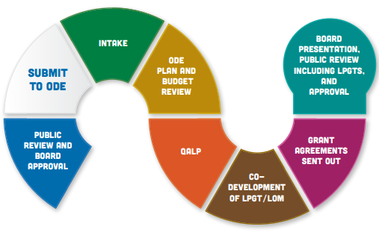
What Happens Next?
WILL RETURN TO PRESENT TO
THE BOARD
*
WE ARE HERE
16
Notes:
Suggested Speaker Notes: Each application will undergo a thorough evaluation process for approval; after which, it will be known as an integrated plan. The timing for this process is outlined on the slide. There are a number of variables, including when applicants submit their initial application and any required follow up of submissions, that can impact these processes.
Additional information as necessary: *QALP(Quality Assurance Learning Panel) will occur simultaneously as the ODE Plan and Budget Review for a randomly selected number of districts. QALP is composed of community members who observe as a quality measure overseeing the review process and requires no additional input from districts.

Slide 17
Questions & Comments
17

